Slide 1



Ghost run
A platform game by Steve Henriquet, Maarten Lebon and Wesly Callaerts

Slide 2


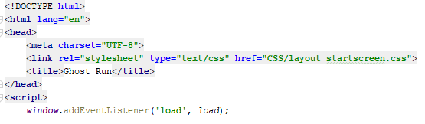
Roles in our team
Wesly: design
Characters and background
CSS (page layout)
Steve and Maarten: development
Game code
Opening screen and highscores code

Slide 3
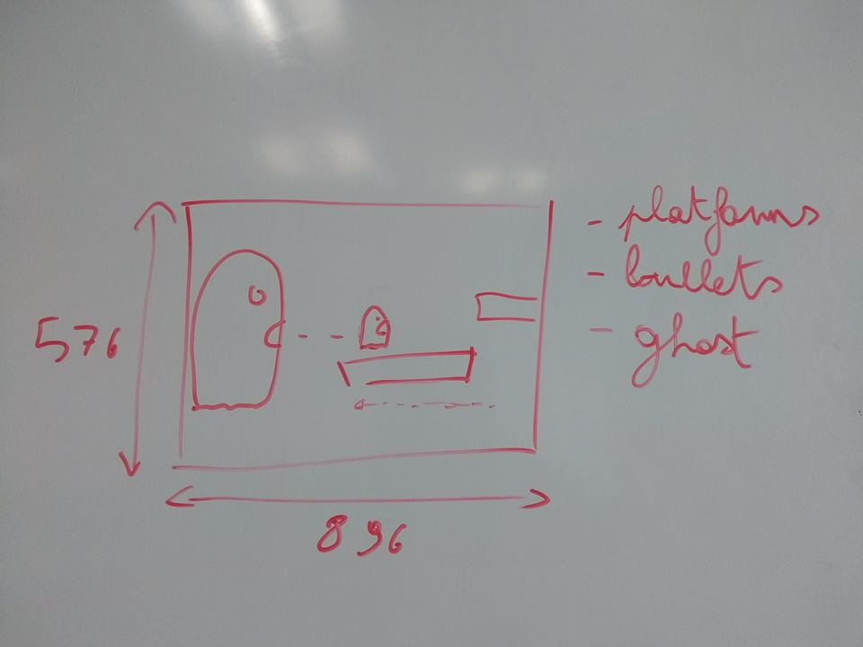
Our approach
Brainstorm
Platform game
Run and jump
Stay in front of the monster
Don’t fall
Don’t get hit by projectiles

Slide 4

Our approach
Prototype
Simple shapes
Character movement
Character death
Simple obstacles

Slide 5
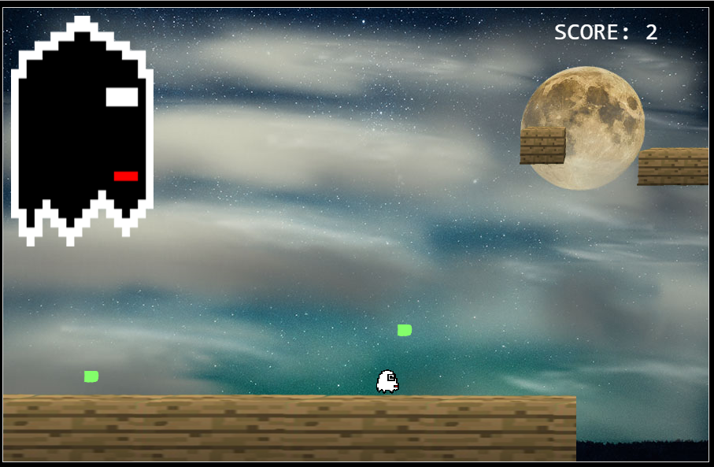
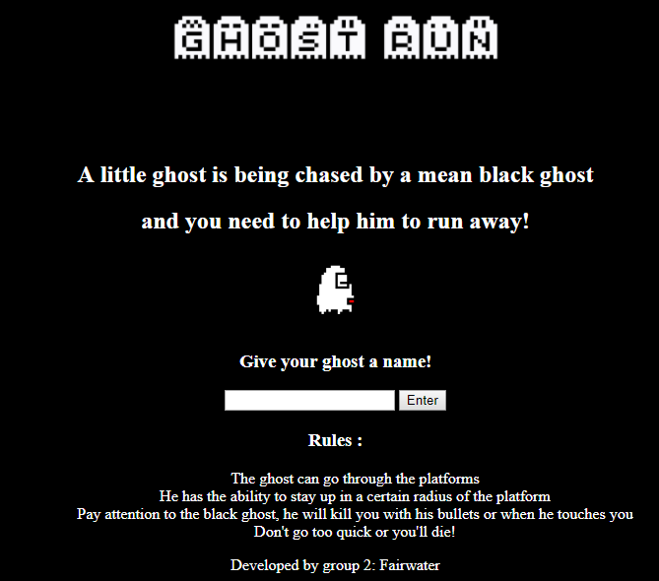
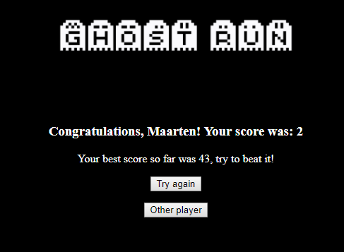
Final game

Slide 6

Evaluation
Teamwork is key
Short time period
Add as many features as possible
Don’t spend too much time on bugs
Example code can help
Using GitHub to share code
Fun experience

